Slide 1
Determining the whole
Understanding multiplicative relationships: fractions and ratio

Slide 2
how to use Oak lessons

Slide 3
I can determine the whole, given one part and the ratio.

Slide 4
Variables are in proportion if they have a constant multiplicative relationship.
A ratio shows the relative sizes of 2 or more values and allows you to compare a part with another part in a whole.

Slide 5

Determining the whole
Bar models to solve ratio problems
Using ratio tables

Slide 6
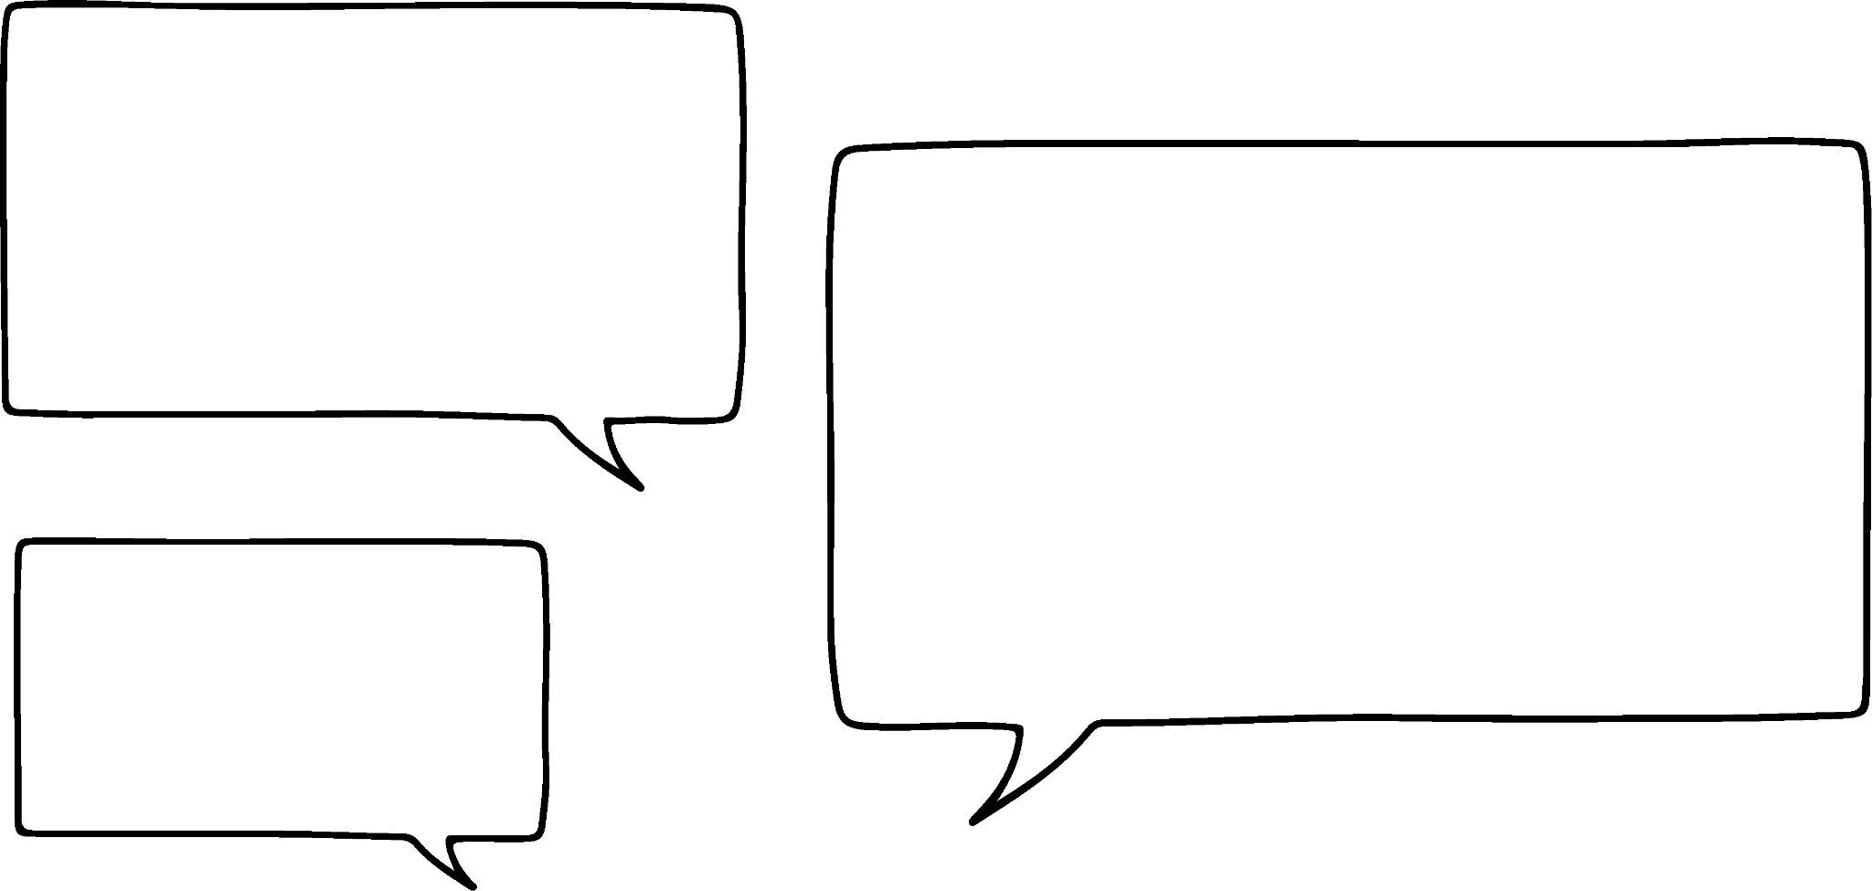


Bar models to solve ratio problems
Lucas is making some necklaces.
He will use black and white beads in the ratio 4 : 1
I am going to use 4 white beads.
How many beads will be on each necklace?
Lucas
Aisha
Let’s draw a bar model to represent this.
Each part of the bar model represents an equal part.
Do you need to find the total number of black beads?
Black
4
4
4
4
5 × 4 = 20
White
4
This means 4 needs to go in all parts.
No, the whole necklace is 5 parts.
Each necklace will have a total of 20 beads.
4

Slide 7


Bar models to solve ratio problems
A bunch of flowers contains red and yellow flowers in the ratio 3 : 5
There are 9 red flowers.
How many flowers are in the bunch?
9 ÷ 3 = 3
Red
3
3
3
3 × 8 = 24
Yellow
3
3
3
3
3

Slide 8
Bar models to solve ratio problems
The ratio of flour to butter to sugar in a cookie recipe is 3 : 2 : 1
You use 45g of flour.
How heavy will the cookie be?
45 g ÷ 3 = 15 g
Flour
15 g
15 g
15 g
Butter
15 g
15 g
6 × 15 g = 90 g
Sugar
15 g
The cookie will weigh 90 g.

Slide 9


Bar models to solve ratio problems
Spot the mistake.
The ratio of red to blue cars in a car park is 5 : 2
There are 30 blue cars.
How many red and blue cars are there in total?
30 ÷ 5 = 6
Red
6
6
6
6
6
7 × 6 = 42
Blue
6
6
30 has been put in the wrong place, it was the number of blue cars not the number of red cars.

Slide 10
Bar models to solve ratio problems
Lucas and Aisha share a packet of sweets in the ratio 7 : 5
Aisha has 30 sweets.
How many sweets were in the bag?
Lucas and Aisha share a packet of sweets in the ratio 4 : 7
Lucas has 28 sweets.
How many sweets were in the bag?
28 ÷ 4 = 7
Lucas
6 | 6 | 6 | 6 | 6 | 6 | 6
7 | 7 | 7 | 7
Lucas
12 × 6 = 72
11 × 7 = 77
Aisha
6 | 6 | 6 | 6 | 6
7 | 7 | 7 | 7 | 7 | 7 | 7
Aisha
30 ÷ 5 = 6
The bag contains 72 sweets.
The bag contains 77 sweets.

Slide 11
Bar models to solve ratio problems
Use a bar model to find the total amount.
a)
b)
6
c)
d)
?
?
18
32
?
?
65

Slide 12
Bar models to solve ratio problems
Use a bar model to find the total amount.
e)
f)
96
g)
h)
?
?
30
84
?
?
175

Slide 13
Bar models to solve ratio problems
2) Use a bar model to answer the following:
Andeep, Sam and Sofia share some sweets in the ratio 3 : 8 : 5
Sam gets 32, how many sweets are there in total?
The lengths of the sides of a triangle are in the ratio of 7 : 6 : 4 The shortest length is 28 cm, what is the perimeter of the triangle?
The ratio of flour to butter to sugar in a cookie recipe is 3 : 2 : 1 You use 135 grams of flour, how heavy will the cookie be?

Slide 14
Bar models to solve ratio problems
Use a bar model to find the total amount.
a)
b)
6
c)
d)
24
44
18
32
27
117
65

Slide 15
Bar models to solve ratio problems
Use a bar model to find the total amount.
e)
f)
96
g)
h)
42
528
30
84
275
120
175

Slide 16
Bar models to solve ratio problems
2) Use a bar model to answer the following:
Andeep, Sam and Sofia share some sweets in the ratio 3 : 8 : 5
Sam gets 32, how many sweets are there in total? 64 sweets
The lengths of the sides of a triangle are in the ratio of 7 : 6 : 4
The shortest length is 28 cm, what is the perimeter of the triangle? 119 cm
The ratio of flour to butter to sugar in a cookie recipe is 3 : 2 : 1
You use 135 grams of flour, how heavy will the cookie be? 270 g

Slide 17
Determining the whole
Bar models to solve ratio problems
Using ratio tables

Slide 18
Using ratio tables
The ratio of orange juice to lemonade in a drink is 3 : 7
Sofia wants to make a jug of the drink.
She has 750 ml of orange juice.
How much drink will she make?
Orange juice | Lemonade
3 | 7
750
Total
10
2500
What is the multiplicative relationship between these?
× 250
Sofia makes 2500 ml of the drink.

Slide 19
Using ratio tables
Lucas and Aisha raise some money doing a sponsored silence.
They split the money between 2 charities in the ratio 4 : 5
Charity A gets £60.
How much money did they raise in total?
Charity A | Charity B
4 | 5
£60
Total
9
£135
What is the multiplicative relationship between these?
× 15
Lucas and Aisha raise £135.

Slide 20
Using ratio tables
Lucas is making some different necklaces with red, blue and white beads in the ratio 2 : 7 : 5
He uses 21 blue beads.
How many beads are on each necklace?
Red | Blue | White
2 | 7 | 5
 | 21
Total
14
42
× 3
Each necklace will have 42 beads.

Slide 21
Using ratio tables
The ratio of red : blue : black cars in a car park is 8 : 5 : 12
There are 96 black cars.
How many red, blue and black cars are there in total?
The ratio of red : blue : black cars in a car park is 8 : 5 : 12
There are 30 blue cars.
How many red, blue and black cars are there in total?
Red | Blue | Black
8 | 5 | 12
 |  | 96
Total
25
200
Red | Blue | Black
8 | 5 | 12
 | 30
Total
25
150
× 8
× 6
There are 200 red, blue and black cars in the car park.
There are 150 red, blue and black cars in the car park.

Slide 22
Using ratio tables
Use a ratio table to find the total given either A or B and the ratio:
Ratio A : B | A | B | Total
1 : 3 | 9
2 : 1 | 36
3 : 8 |  | 128
4 : 5 |  | 225
2 : 5 |  | 1500
7 : 3 | 84
2 : 9 | 845
4 : 7 |  | 47.6

Slide 23
Using ratio tables
2) Use a ratio table to answer the following:
Andeep, Sam and Sofia share some sweets in the ratio 3 : 8 : 5
Sam gets 40, how many sweets are there in total?
The lengths of the sides of a triangle are in the ratio of 7 : 6 : 4 The longest length is 14 cm, what is the perimeter of the triangle?
The ratio of flour to butter to sugar in a cookie recipe is 3 : 2 : 1 You use 126 grams of butter, how heavy will the cookie be?

Slide 24
Using ratio tables
Use a ratio table to find the total given either A or B and the ratio:
Ratio A : B | A | B | Total
1 : 3 | 9 | 27 | 36
2 : 1 | 36 | 18 | 54
3 : 8 | 48 | 128 | 176
4 : 5 | 180 | 225 | 405
2 : 5 | 600 | 1500 | 2100
7 : 3 | 84 | 36 | 120
2 : 9 | 845 | 3802.5 | 4647.5
4 : 7 | 27.2 | 47.6 | 74.8
You did not need to find the numbers in grey but they are shown here in case you did.

Slide 25
Using ratio tables
2) Use a ratio table to answer the following:
Andeep, Sam and Sofia share some sweets in the ratio 3 : 8 : 5
Sam gets 40, how many sweets are there in total? 80 sweets
The lengths of the sides of a triangle are in the ratio of 7 : 6 : 4 The longest length is 14 cm, what is the perimeter of the triangle? 34 cm
The ratio of flour to butter to sugar in a cookie recipe is 3 : 2 : 1 You use 126 grams of butter, how heavy will the cookie be?
378 g

Slide 26
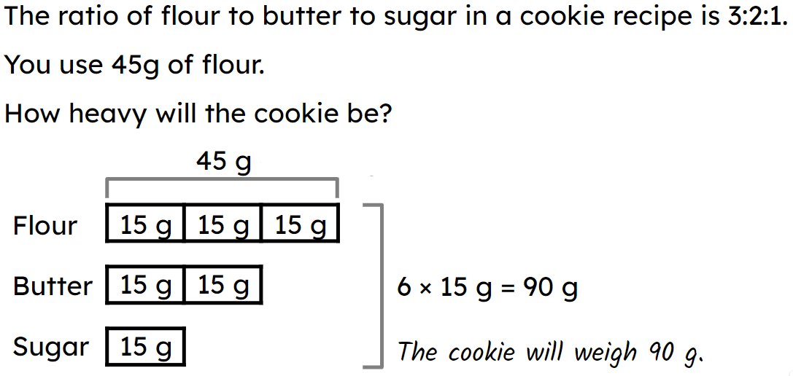
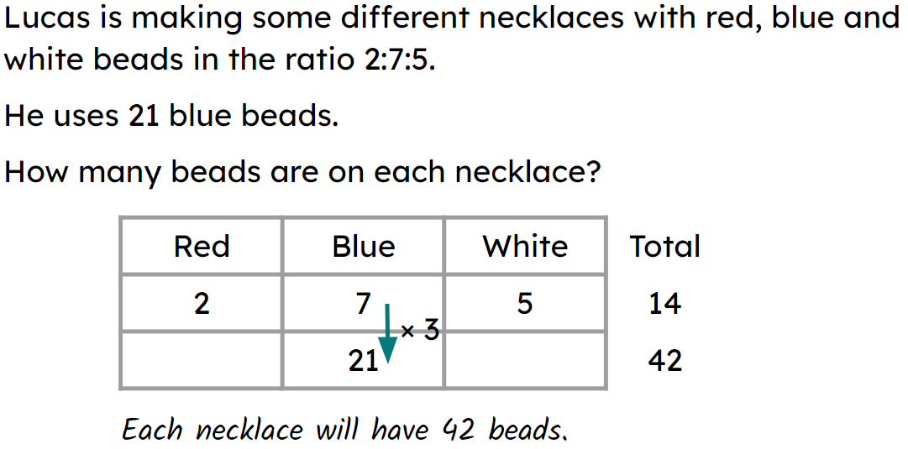
Determining the whole
A bar model can be used to determine the whole.
E.g.
A more efficient way to determine the whole is to use a ratio table.
E.g.

Slide 27

© Oak National Academy 2023.
Produced in partnership with Mathematics in Education and Industry.
Licensed on the Open Government Licence v3.0, except where otherwise stated. See Oak terms and conditions.

